Slide 1
Accuracy in writing. Abbreviations. Academic vocabulary. Types of writing. Grammar. Nouns. Adjectives. Verbs. Adverbs. Pronouns and determiners. Conjunctions and prepositions. Phrases. Clauses. Which and that. Grammar matters. Word choice. Levels and concentrations. Untying the negatives. Abbreviations. Spelling. Words matter. Punctuation

Slide 2
Sneaky plurals
This convention of adding an “s” to form a plural works well for most words except words of Latin or Greek origin. For example, formulae is the plural of formula and criteria is the plural of criterion. Some obscure plurals to be on the look out for are those such as media, which is the plural of medium, and data which is the plural of the rarely used Latin word datum. In matching the word data with a verb, you must never write the data is but rather be grammatically correct and write the data are. However, if you are writing about a data bank, the noun bank is singular and so you write the data bank is stored here.

Slide 3
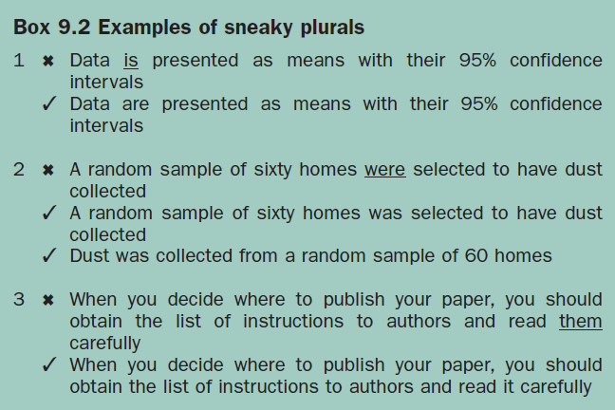

Slide 4
Adjectives
When two or more adjectives are used in a list, they are separated by a comma as in small, unrepresentative samples and in large, cross-sectional survey. However, when adjectives are joined with a noun to form a noun cluster, as in noninsulin dependent diabetes or effective weight loss intervention strategies no comma is needed. In some sentences, the adjective almost acts like a noun when it is the object of the sentence. For example, in the phrase self-reported weights may be unreliable, the word unreliable is an adjective that describes self-reported weights but it acts as the object of the sentence.

Slide 5
Verbs
To complicate matters even further, verbs can take an “active” or a “passive” form. Fortunately, computer grammar checkers often alert us if we use a passive verb form. One way to recognise the passive form without relying on computer alerts is that the verb is usually a cluster of several words and the subject often follows the verb rather than leading the sentence. For example, you can write that People are considered to be at higher risk for having heart disease if they are obese or that Obesity is a risk factor for heart disease. In the first sentence, the subject is people and there is a passive verb cluster are considered to be. However, the second sentence correctly has the subject obesity at the beginning and uses an active verb is. Use an active verb rather than a passive verb whenever possible.

Slide 6
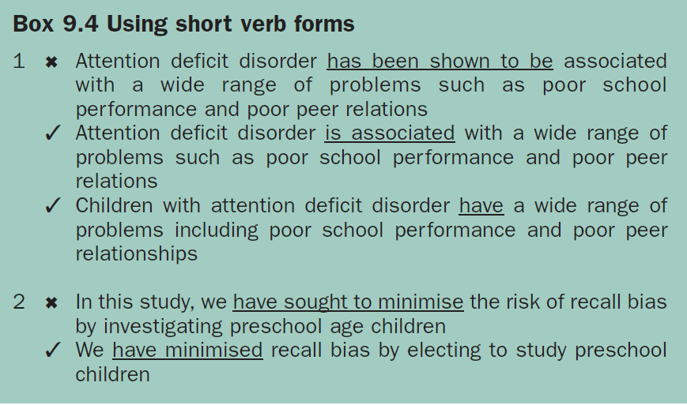

Slide 7
Abbreviations
Abbreviations should also be avoided whenever possible. Unless your abbreviation refers to a standard measurement, such as cm or mm, the full term for which it stands should precede its first use in the text. Once an abbreviation is defined, then you must use it throughout your paper in preference to the full expression. The uniform requirements for manuscripts5 states that only standard abbreviations should be used in the text and that abbreviations should not be used at all in the abstract and in the title. This is excellent advice. It is certainly not a good idea to invent your own abbreviations that the reader has to remember while reading your paper. It is even harder for readers when you invent two or three new abbreviations and use them throughout the paper. This practice of creating alphabet soup detracts from clarity and readability.

Slide 8
Spelling
Poor spelling must be avoided at all costs because it annoys readers, can be confusing if another meaning is attached to a word and, with the advent of computer programs with dictionaries and spell-checking facilities, is no longer excusable. Although some sympathy is often extended to researchers who have to write in English rather than their own language, most reviewers find incorrect spelling irritating. If you know that you are prone to spelling a word incorrectly, then you should search your paper for that word and replace it correctly.

Slide 9
Be aware that the spell checker may not pick up an incorrectly spelt word if the form you have used is a valid sequence of letters. For example, you may type you instead of your or rates instead of rats. There is no substitute for careful proofreading, and careful peer reviewers and copy editors. You will also have to choose a spelling standard that is appropriate for the journal that you send your paper to. Some journals are quite specific about which dictionary to use, for example the BMJ recommends Chambers 21st century dictionary for general use and Dorlands dictionary for medical terms and the Australia and New Zealand Journal of Psychiatry requests that papers are spell-checked using the Macquarie dictionary.

Slide 10
Words matter
Word tips:
Standardise all terms
Maintain consistency in orders and viewpoints
Check that the words mean what you want them to mean
Adhere to humanising and non-emotive terms
Avoid double or unnecessary negatives
Only use standard abbreviations
Spell check and proofread your paper

Slide 11
Punctuation matters
Checking out the punctuation:
End sentences with full stops
Avoid colons and semicolons when possible
Put commas and apostrophes in the correct places
Eliminate all but the most essential hyphens and brackets

